Slide 1
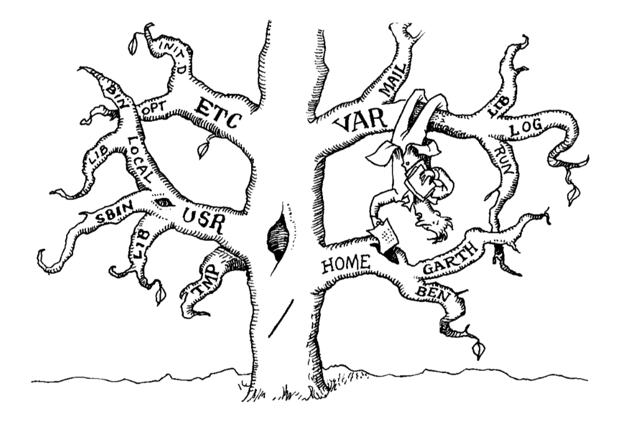
The Filesystem

Slide 2
The Filesystem
Basic Purpose: to represent and organize the system’s storage resources
Also: represents a ton of other systems as files (devices, busses, etc.)
Comprised of four main components:
Namespace: a way to name things and organize them in a hierarchy
API: a set of system calls for navigating and manipulating objects
Security Models: schemes for protecting, hiding, and sharing things
Implementation: software to tie the logical model to the hardware

Slide 3
Pathnames
Absolute paths start from the root directly /
/etc/apache2/httpd.conf
Relative paths are invisibly prepended with your current working directory
apache2/httpd.conf -> /etc/apache2/httpd.conf
(the above assumes our current working directory is /etc)
The locations . and .. are special files which refer to the current and parent directories, respectively
Notes:
Also, it is a directory not a folder

Slide 4
mount and automounting
The command mount is used to attach a file system to your full file tree, and unmount is used to remove it
mount can attach any file system (including ones already connected to the file tree somewhere else, remote drives, other disks, etc.) to the file tree via a mount point
The mount point is (usually) an empty directory which will have its contents overwritten with the mounting file system
File systems which should be automatically mounted at boot are listed at /etc/fstab and this file can be modified to add/remove boot file systems

Slide 5
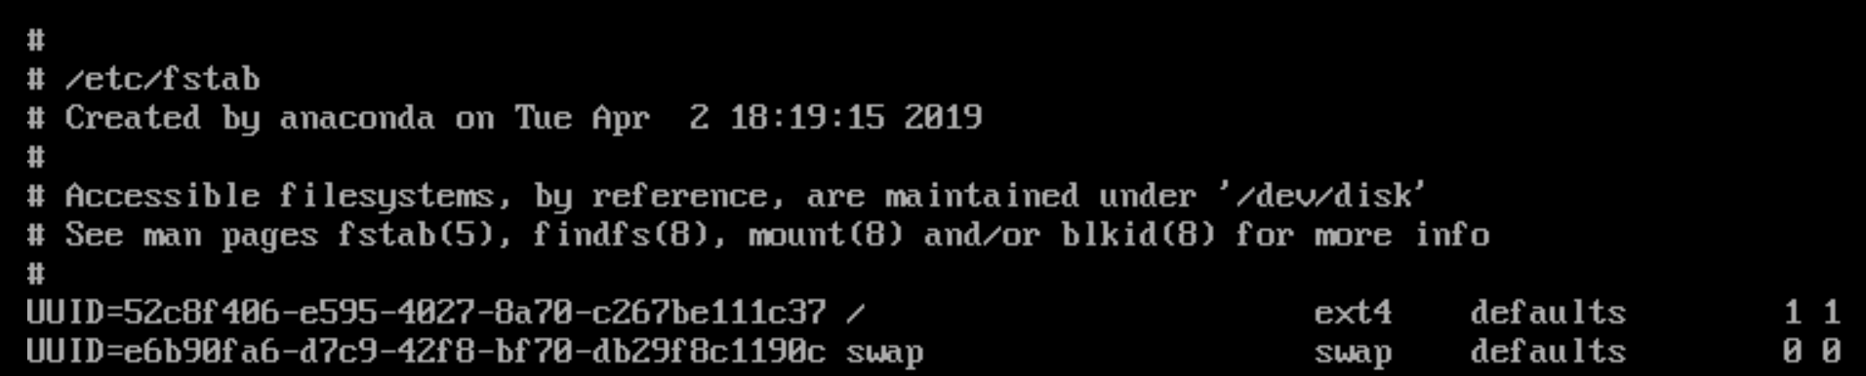
Use lsblk and blkid to find the UUID for the file system you want to automount
Create a backup of the /etc/fstab file (example: /etc/fstab.old)
Create an empty directory to use as a mount point
Fill in the following fields in /etc/fstab
UUID, mount point, file system type, mount options (defaults usually), dump, fsck
Notes:
dump value of 0 means it shouldn’t be dumped (backed up) and 1 means that it should be.
fsck value of 1 means its a root directory, 2 means it is not root, 0 means it shouldn’t be checked, fsck checks for errors in the disk.
The above example is the contents of the /etc/fstab file on the CentOS7 installation you did in lab if you set up the partitions and mount points correctly

Slide 6
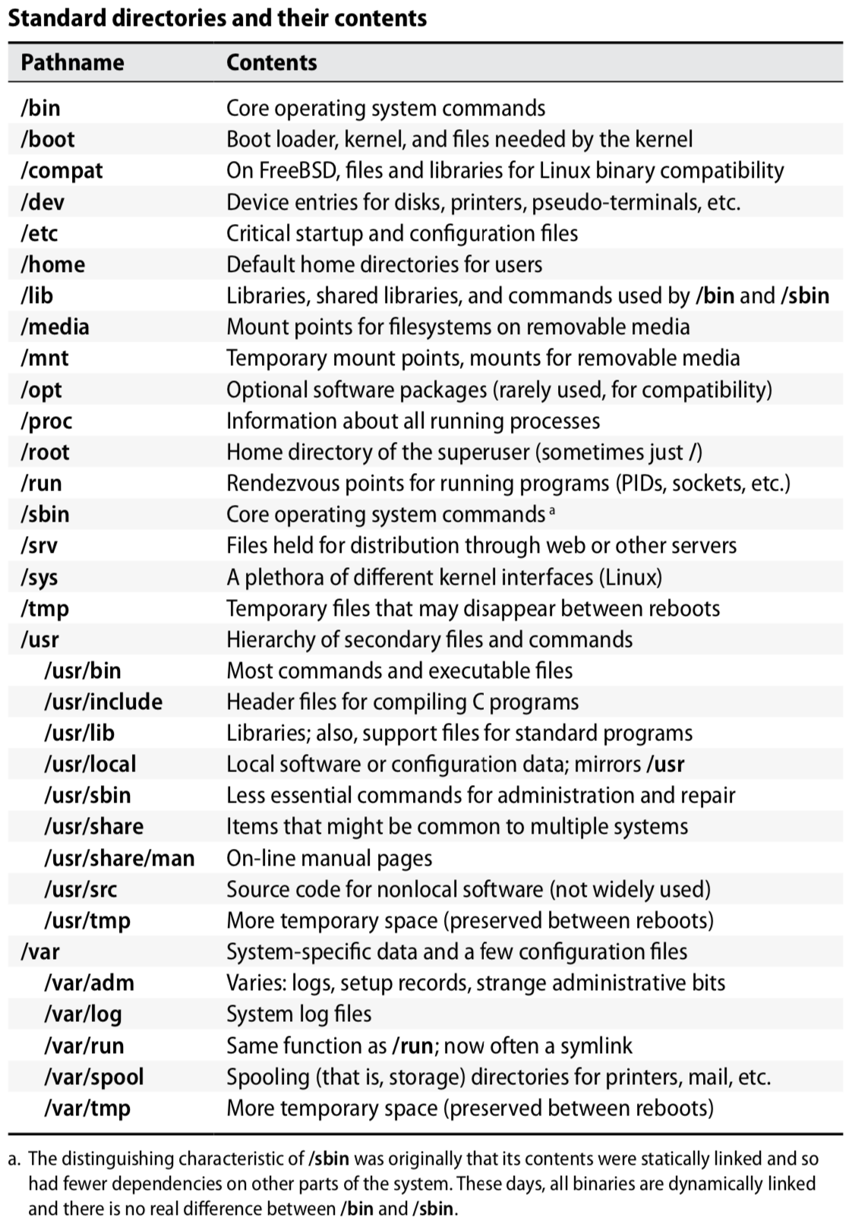

Slide 7
File Types
There are seven typical types of files
Regular files
Directories
Character device files
Block device files
Local domain sockets
Named pipes (FIFOs)
Symbolic links
Even when creating a new system that utilizes the file abstraction, you must make your file look like one of these types
Use the file command to find which type a file is

Slide 8
File Types
Regular Files
Series of bytes with no structure imposed by the filesystem
Directories
Named references to other files with special entries . and .. automatically added (which cannot be removed)
Hard Links
File names are stored in the parent directory, not with the file itself
More than one link can refer to a file at once, and the reference can have different names (but cannot cross file systems)
Hard lines are created using ln existingfile newlinkname

Slide 9
File Types
Symbolic Link
Reference to a file by name, and can be absolute or relative
Symbolic links are distinct from the files they point to, where as hard links are actual reference to a specific file
Character and Block Device Files
Abstraction for communicating with system hardware and peripherals
Files system requests that refer to a character or block device file are passed to the associated device driver
Device driver is a process (usually a daemon) which takes care of running and interfacing with the device or peripheral
Device files have an associated major device number (specifies driver) and a minor device number (used by driver, usage varies by device)
Notes:
Hard links
Only link to a file not a directory
Can not reference a file on a different disk/volume
Links will reference a file even if it is moved
Links reference inode/physical locations on the disk
Symbolic (soft) links
Can link to directories
Can reference a file/folder on a different hard disk/volume
Links remain if the original file is deleted
Links will NOT reference the file anymore if it is moved
Links reference abstract filenames/directories and NOT physical locations. They are given their own inode
The major device numbers and what driver they belong to are listed in /proc/devices and the minor numbers are pass to the driver itself and has specific meaning to the driver

Slide 10
File Types
Local Domain Sockets
Connections between processes that allow them to communicate easily
These sockets are only available through the local host so are referred through the file system rather than a network port
Named Pipes
Serves a similar purpose to local domain sockets
These files are a historical artifact, and local domain sockets are essentially a superset of named pipes
Notes:
UNIX-domain sockets are generally more flexible than named pipes. Some of their advantages are:
You can use them for more than two processes communicating (eg. a server process with potentially multiple client processes connecting);
They are bidirectional;
They support passing kernel-verified UID / GID credentials between processes;
They support passing file descriptors between processes;
They support packet and sequenced packet modes.

Slide 11
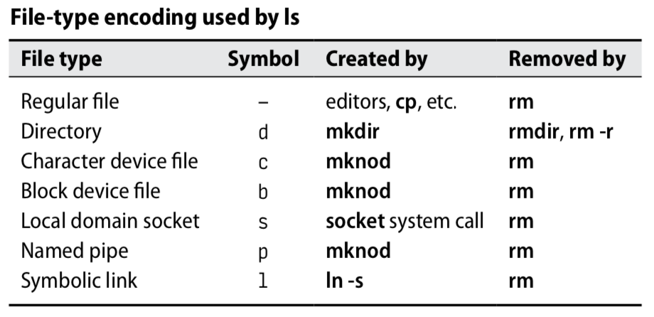

Slide 12
File Permissions
Each file has 9 permission bits: 3 for the owner, 3 for the group, and 3 for all
These are often set with octal (base 8) numbers
The topmost three bits (400, 200, 100) represent user permissions
The middle three bits (40, 20, 10) represent group permissions
The lowest three bits (4, 2, 1) represent all permissions
The high bit is the read bit, the middle bit is the write bit, the low bit is execute
Only the most specific permissions apply when a user fits into multiple categories

Slide 13
Special Permission
The octal values 4000 and 2000 are the setuid and setgid permission bits
The octal value 1000 is used for the sticky bit, which is ignored on normal files
The sticky bit, when set on a directory, means that the directory and files within it can only be removed by the file/directory owner or superuser
Linux systems also have a number of “bonus flags” which can only be viewed and modified with lsattr and chattr respective
These “bonus flags” can further modify the filesystem but are not available on all file systems, consult the chattr man page for more specifics
Primarily this is only necessary to check if a file is acting irregularly

Slide 14
ls for special cases
The ls -l command will show the following for the special permission bits
The setuid bit replaces the owners x bit with an s
The setgid bit replaces the groups x bit with an s
The sticky bit replaces the other’s x bit with a t
If these bits are set but the execution bit is not, then it will be S or T
The ls command lists the number of hard links after the permission bits, the file will only be removed from disk when there are no hard links
For device files, the file size is replaced with the major and minor device numbers
Notes:
symbolic links don’t count in the number of links printed by ls

Slide 15
Access Control Lists (ACL)
More powerful but more complicated way of regulating access to files
Two predominant “standards”:
POSIX ACL: Primarily extends the normal permissions to be specified for additional numbers of specific users and groups (supported by both Linux and FreeBSD)
NFSv4 ACL: Superset of POSIX ACL as well as Windows ACL to work across systems (supported by FreeBSD and indirectly via NFS daemon)
ACLs should primarily be used when windows support or the level of flexibility needed is beyond UNIX permissions
ACLs can cause unexpected interactions with ACL-unaware backup systems, network file systems, and other programs
Notes:
Note that the POSIX version is not actually based on an approved standard (as there were specifications, but a standard was never approved), but these days are fairly standard across implementations.

Slide 16
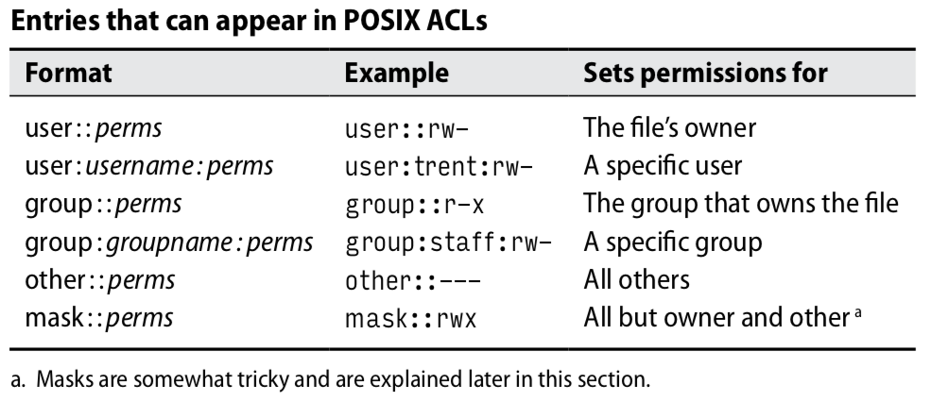
POSIX ACLs
Allows for the rwx permission bits to be set independently for any combination of users and groups
Set and queried on files using the setfacl and getfacl commands, respectively (ls will show a + after permission bits to indicate an ACL exists)
Notes:
In order to try and coordinate the ACL permissions with traditional permissions (and by extension, programs that don’t know how to interpret ACLs) both the chmod and setfacl will re-modify the permission bits (or ACL) to try and keep them aligned. However, because the ACL specififes a superset of permissions which (in many cases) will be above and beyond the typical permission bits the permissions seen by a non-ACL program may not mimic reality if the ACL is more specific because additional user:: or group:: ACLs are set.
Because of this, ACLs create a mask which tries to reconcile the fact that programs don’t know about ACLs. This mask can never understate the access allowed by the ACL as a whole, although there are issues that can still arise.

Slide 17
Questions?

Slide 18
Additional Resources
fsck man page
Understanding Symbolic Links
Hard Link and Symbolic Link??
An Advanced Socket Communication Tutorial
chattr man page
HOWTO: Use NFSv4 ACL
Understanding NFSv4 ACL’s

